Slide 1
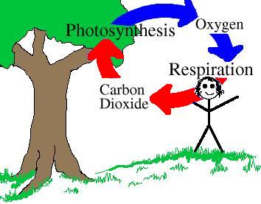
Explore Cellular Respiration

Slide 2
Your Job Is:
Find out what cellular respiration is and how it is connected to photosynthesis.
Use the internet as your resource.
Make a model representing cellular respiration (and the relationship to photosynthesis)
Label the model
Make it colorful
You may work with a partner
The model is due on Friday

